Slide 1

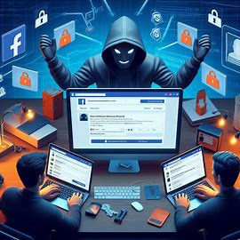

PHISHING ATTACK
Threats and Type of Attack How to protect yourself
Code Alpha
0
1

Slide 2

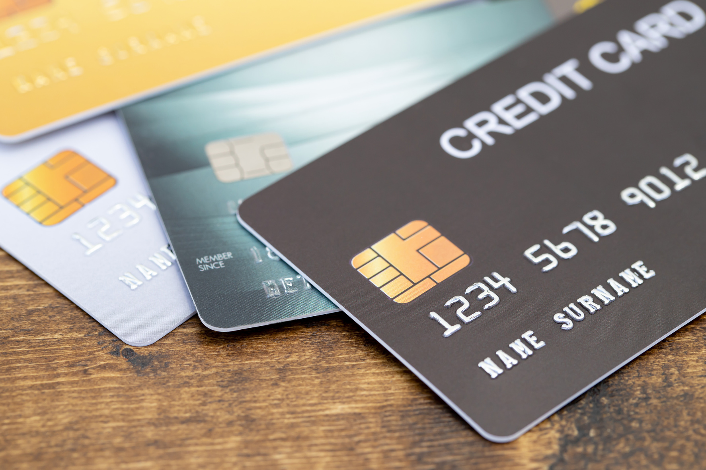





What is phishing attacks.
phishing is when someone tries to trick yo into revealing personal information like your password, credit card numbers , or social security number.
01
2

Slide 3


HOW TO RECOGNIZE PHISHING EMAILS AND FAKE WEBSITES
Check for HTTPS
Check the sender’s email
Look for poor grammar/spelling
Avoid suspicious attachments
Beware of urgent threats
02
3

Slide 4

BEST PRACTICES AND TIPS
1-Phishing
2-Pretexting
3-Baiting
4-Quid Pro Quo
5-Tailgating
6-Impersonation
7-Scareware
03
4

Slide 5


PHISHING
Fake emails, texts (smishing), or calls (vishing) impersonating trusted sources.
Example: "Your bank account is locked! Click here to unlock it.
PRETEXTING
Creating a fake scenario (e.g., IT support) to extract information.
Example: "We need your password to fix an issue."
04
5

Slide 6


BAITING
Luring victims with free downloads (movies, games) containing malware.
Example: "Download this free software!"
QUID PRO QUOSIS
Offering help in exchange for sensitive access.
Example: "Disable your antivirus so I can fix your PC."
05
6

Slide 7
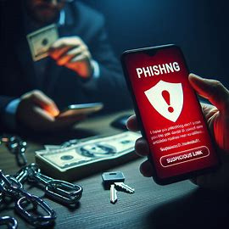

IMPERSONATION
Pretending to be a manager, police, or bank official.
Example: "This is your CEO—transfer $10K urgently!"
SCAREWARE
Fake virus alerts or legal threats to create panic.
Example: "Your device is infected! Click to scan now!"
06
7

Slide 8
LAST BUT NOT LEAST, DO NOT TRUST ANYTHING YOU SEE WITH YOUR EYES. THINK WITH YOUR MIND, NOT YOUR HEART.
7
8

